Slide 1
TEXT CLASSIFICATION
USING BAG OF WORDS & Naïve Bayes
FROM SCRATCH
(Mathematical steps explained)
Ramendra Kumar

Slide 2
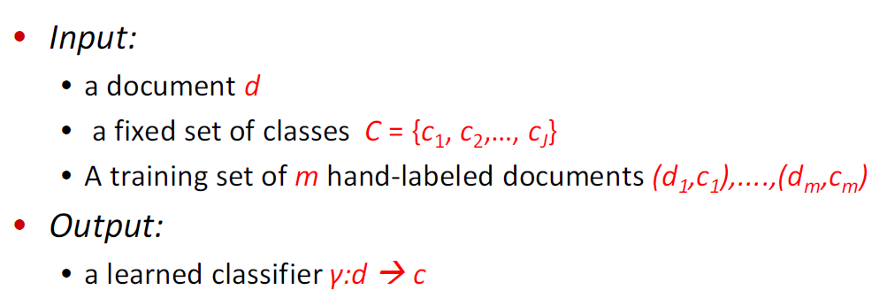
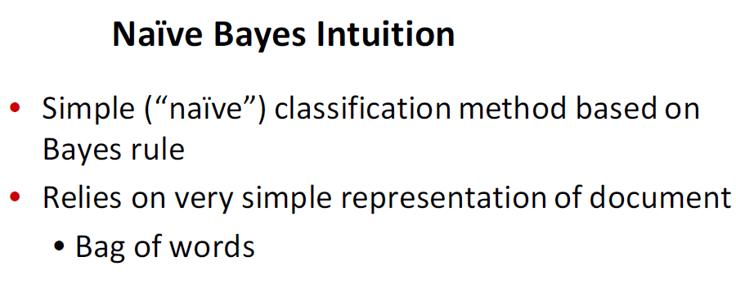

Slide 3


Slide 4
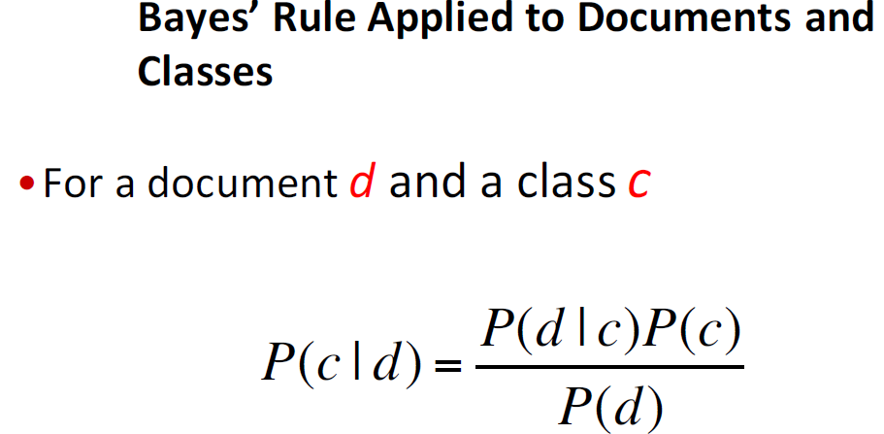
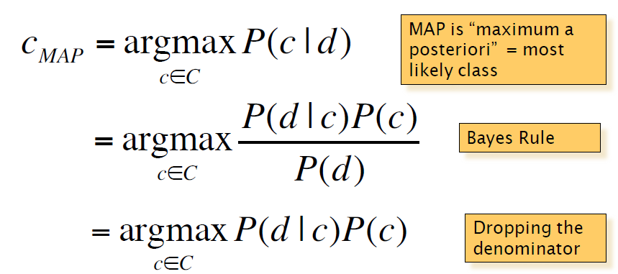
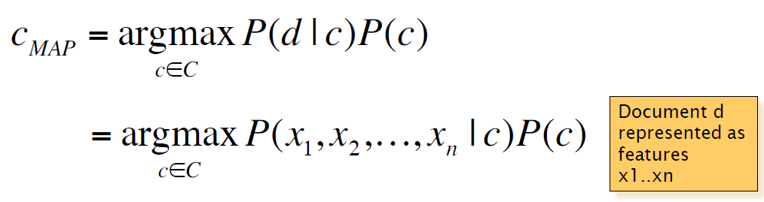

Slide 5
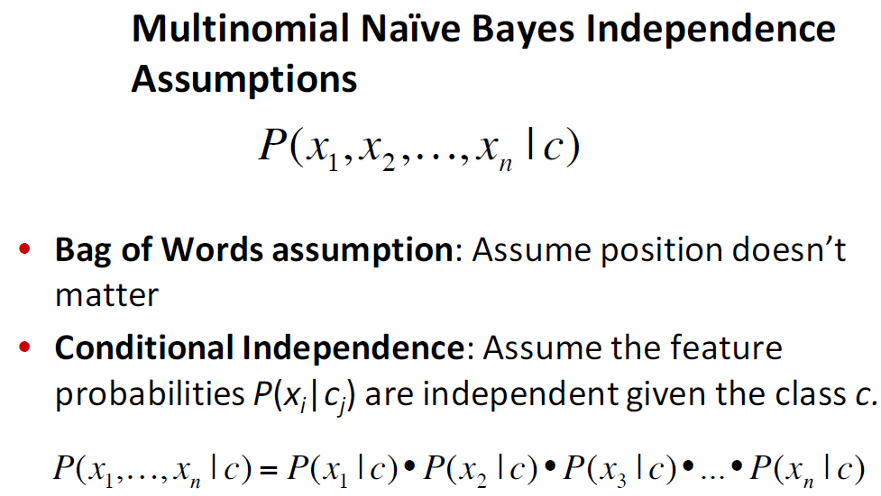

Slide 6
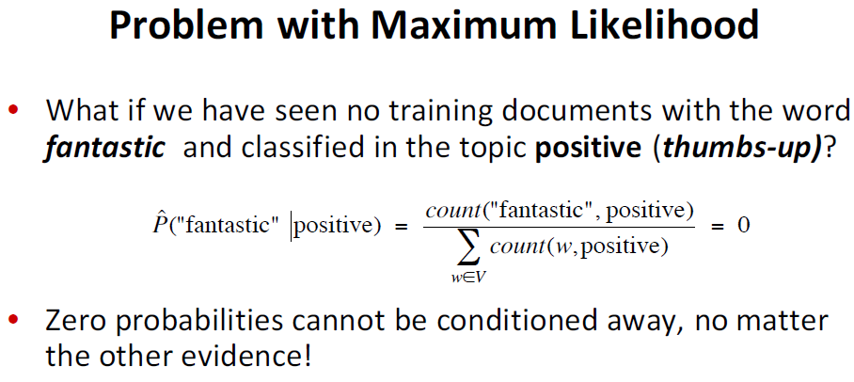
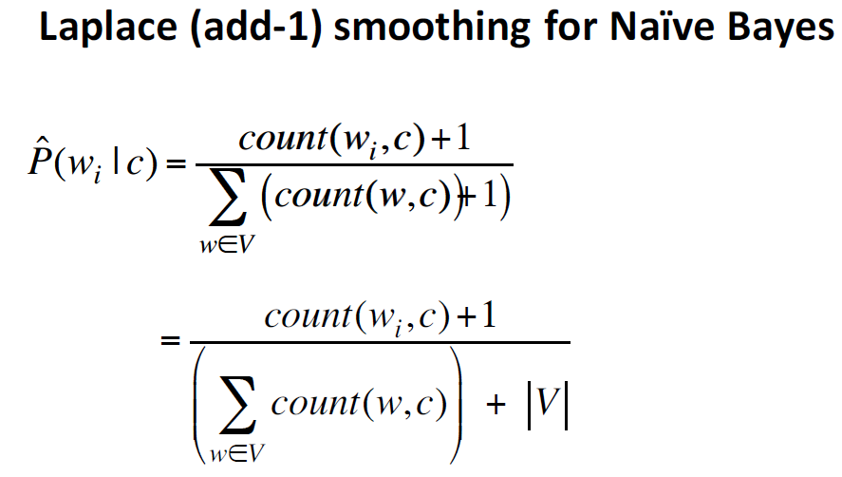

Slide 7
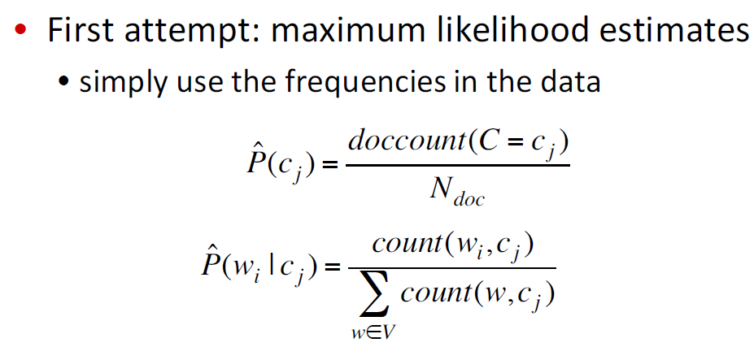
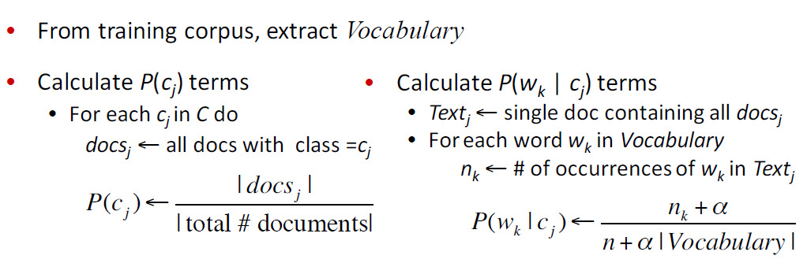

Slide 8
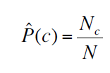
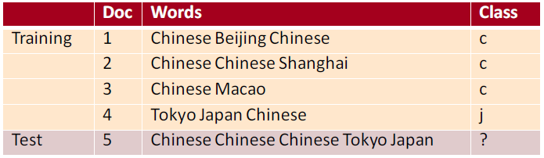
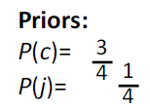
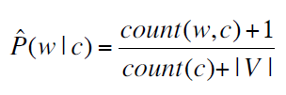
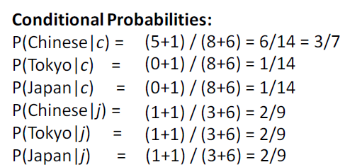
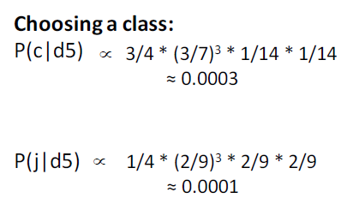
Pc= Probability of Class
Nc = Number of document for that class
N=Total number of documents
Likelihood of a word given a class =
Count of the word in that class/count of all words in that class
|V| = counting of unique vocabulary (words) in whole documents
α = 1, Laplace smoothing

Slide 9
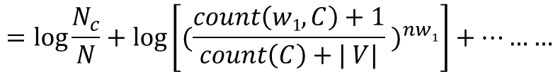
Finally, P(c|d )= Probability that a document ‘d’ lie in class ‘c’
$= \frac{N_{c}}{N} ×{(\frac{count\left(w1,C\right)+1}{count\left(C\right)+| V|} )}^{nw1}×{(\frac{count\left(w2,C\right)+1}{count\left(C\right)+| V|} )}^{nw2}×{(\frac{count\left(w3,C\right)+1}{count\left(C\right)+| V|} )}^{nw3}×$ …………
Taking Log and calculating :>
$$=log{\frac{N_{c}}{N}}+\log\left[{(\frac{count\left(w1,C\right)+1}{count\left(C\right)+| V|} )}^{nw1}\right]+………$$
$$= log N_{c}−\log{N}+ {nw}_{1}×\left\{\log\left[count\left(w1,C\right)+1\right]−\log\left[count\left(C\right)+\left| V\right|\right]\right\}+….. for all words in test set$$
Where,
nw₁ =Number of word ‘w₁’ in test document
Nc=number of document in that class ‘c’
N=Total Number of documents
Count(w₁,c)= count of word w1 in that class
Count(c) =count of all words in that class
|v|= counting of unique vocabulary (words) in whole documents

Slide 10
Thanks !

